Slide 1


Al Mkni fi’l-jabr wa’l-muqābala Exposition of Algebraic Operations a poem by Ibn Al-Ha’im
Ishraq Al-Awamleh
ishraq@nmsu.edu
Department of Mathematical Sciences
New Mexico State University
MAA MathFest 2016, Columbus, OH
August 6, 2016
Download presentation from: ishraq.me

Slide 2
Outline
Definition of al-jabr wa’l-muqābala
About the Author: Ibn Al-Ha’im
About the Poem
The Poem Manuscript
Poem Sections
Conclusions
Acknowledgments
References

Slide 3
Definition of al-jabr wa’l-muqābala
From Al-Khwarizmi [4](780-850 AD) the word algebra is a Latin variant of the Arabic word al-jabr.
al-jabr and al-muqubalah are two basic operations in solving equations:
Jabr was to transpose subtracted terms to the other side of the equation.
Muqubalah was to cancel like terms on opposite sides of the equation.
Eventually al-muqabalah was left behind, and this type of math became known as algebra in many languages.

Slide 4
About the Author: Ibn Al-Ha’im
Full name : Ahmad bin (son of) Imad Eddin bin (son of) Ali (AKA Ibn Al Ha’im)
Mathematician and theological scholar
He was born in Egypt, 1356 – 1412 AD (753-815 AH)
He lived in Jerusalem (he was AKA Al-Maqdisi, which means “from Jerusalem”)
He worked in Jerusalem to teach mathematics
His way of teaching was based on piety
He urged his students to be exemplary in working hard and sticking to religion

Slide 5
About the Poem
Al Mkni fi’l-jabr wa’l-muqābala
Exposition of Algebraic Operations
A versified poem - consists of 59 lines
Category: instructions in arithmetic and algebra
Introduces different terms used in algebra, addition and subtraction, multiplication and division, and the six canonical equations.

Slide 6
About the Poem
The Egyptian National Library acquired it in 1921 AD (1326 AH?)
It is also in the Library of Congress
Never before translated into English
Arabic Interpretations are in the Library of Congress

Slide 7
Poem’s background
1402
Composition of the poem
(Ibn al ha’im)
1882
Copying of the poem
(writer: Abdel fattah)
4-1888
First Interpretation of the poem in
Arabic[3]
(writer: Taha Bin Yusuf)
8-1888
Second interpretation based on the First[6]
(Writer: Taha Bin Yusuf)
Source: Writer’s teacher
Sheikh Hassan al- Attar Azhari
Source: Zakaria Al-Ansari
Source: Ahmad Al-Maliki

Slide 8
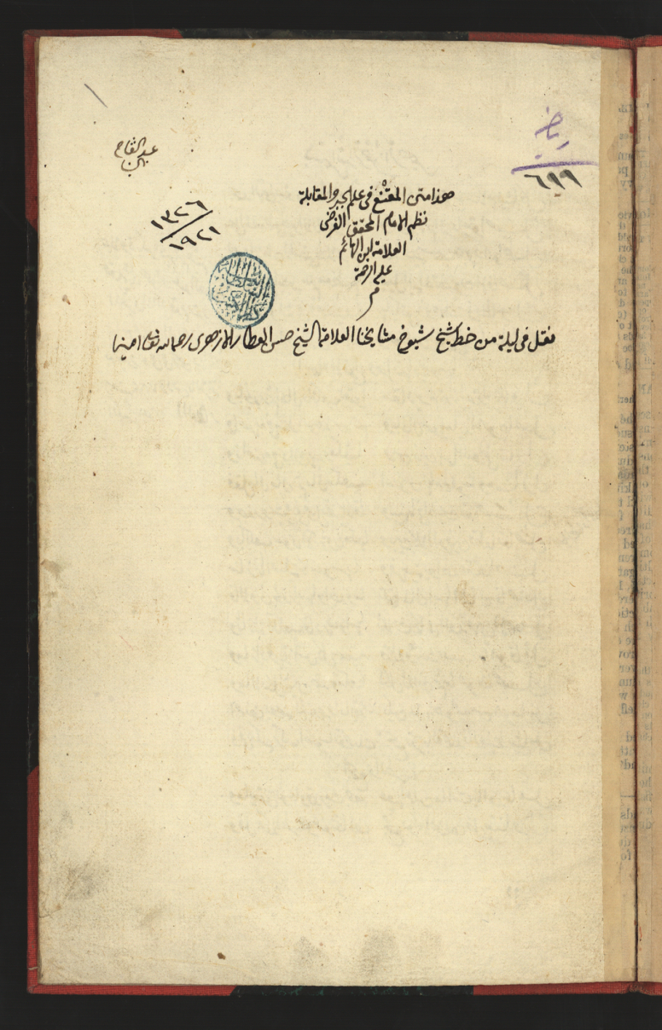
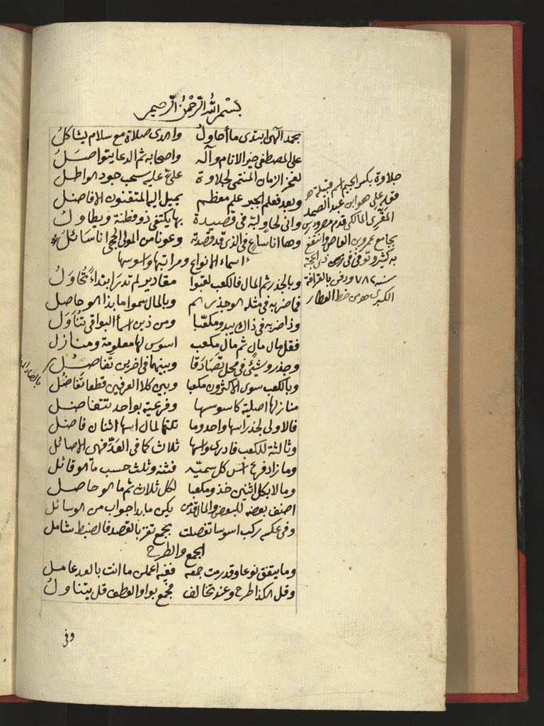
Poem Manuscript-1: Source - Egyptian National Library
Name of the copier
Section title: Names of types, and its orders and exponents
Math 611
Introduction
Al Mkni fi’l-jabr wa’l-muqābala for Ibn al hai’m
Margin: explains the word Jelawa, the name of the tribe of his teacher
The Archiving date.
Section title: Addition and Subtraction
It was written from a copy of shaik Hasan Al attar

Slide 9
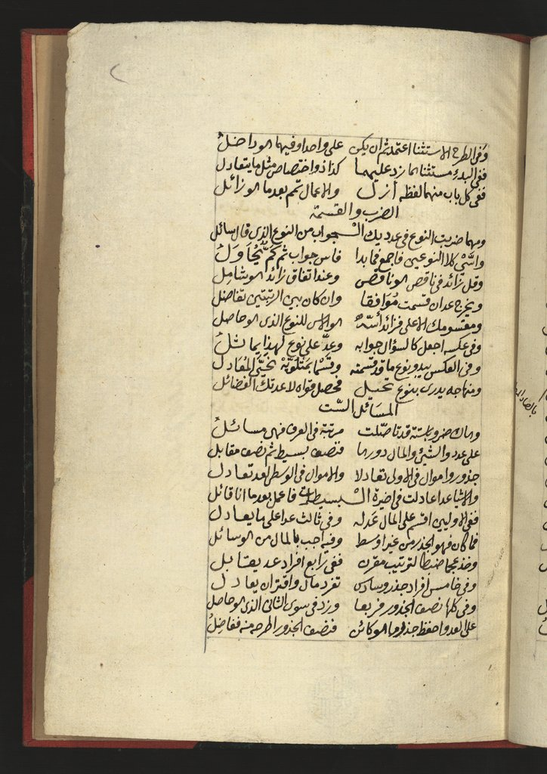
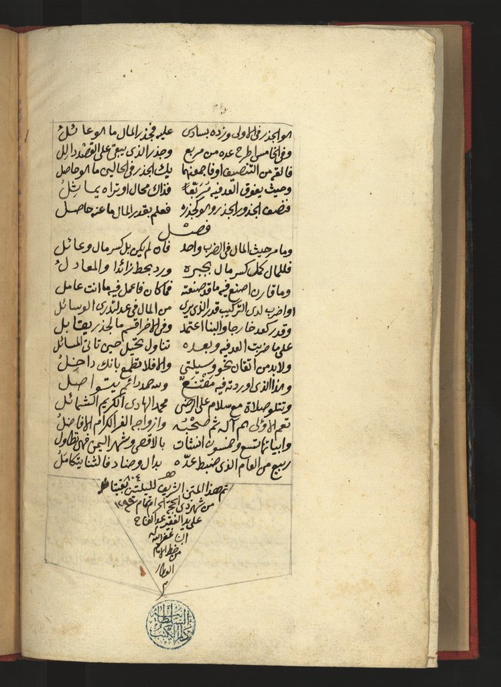
Poem Manuscript-2
Section title: Multiplication and Division
Section title: Wrap up
It was copied in 1299 AH
by Abdel Fattah, citing the copy of his teacher, Sheikh Hassan al- Attar Azhari, as his source.
Section title: The six canonical equations

Slide 10
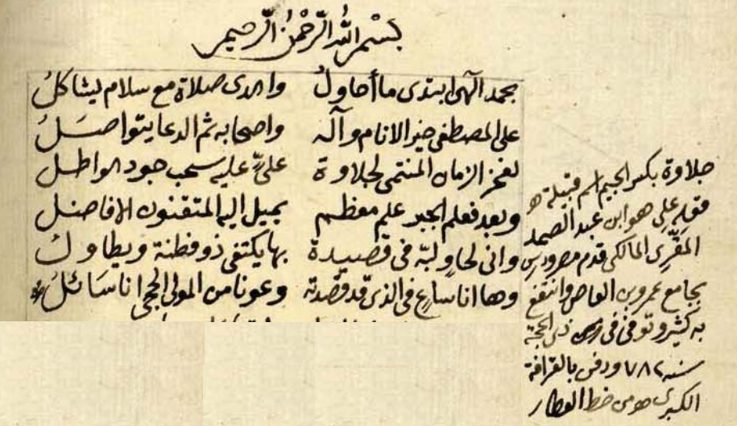
Poem Sections: Introduction
Thanks addressed to the creator and his prophet
A tribute to the author’s mathematics teacher, Abi Al-Hasan Ali Al Jalawi

Slide 11
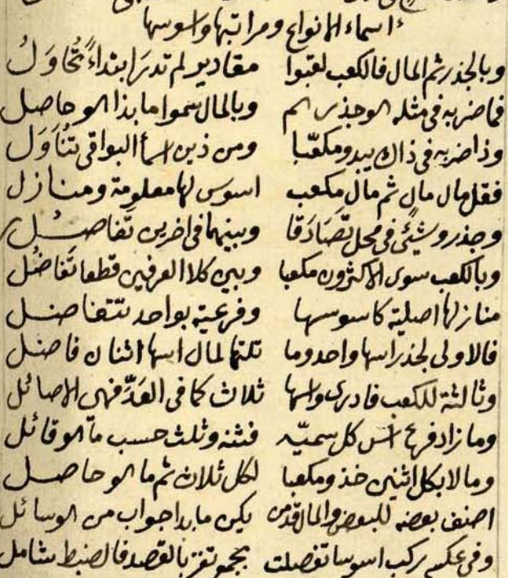
Poem Sections: Names of types, their orders and exponents(1)
Jidhr (root) means a number, its plural is ajdhar.
Shay (thing) means unknown (our modern x), its plural is Ashya’.
Māl means a square that can be used with both number and x, its plural is amwāl.
Ka’ab means a cube that can be used as cube of a number or a cube of x , its plural is ak'ab.
Aus means exponent:
a Jidhr (number) or shay (x) has exponent one; followed by māl (square), which has exponent two; then ka’ab (cube) has exponent 3.

Slide 12
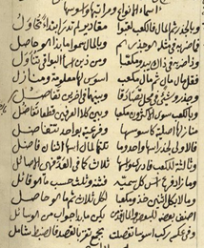
Poem Sections: Names of types, their orders and exponents(2)
If an unknown x is multiplied by itself, the unknown x is called a thing or a root
If a known number is multiplied by itself, the number itself is called a root (not a thing)
In both cases, the result of such multiplication is a square (māl)
If a square (māl) is multiplied by a root (jidhr) the result will be a cube (ka’ab)

Slide 13
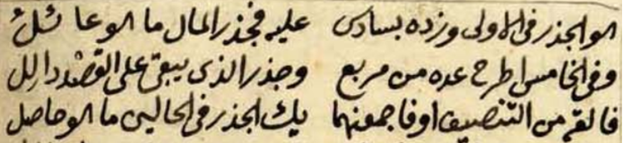

Slide 14
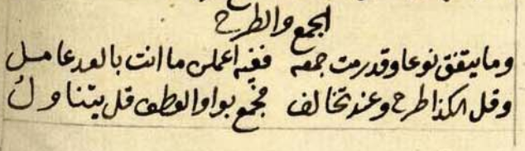
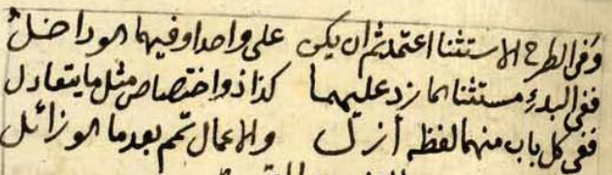
Poem Sections: Addition and Subtraction
Adding and subtracting two quantities of the same type (root, square, or cube) is the same as adding numbers
Example 1: 3 squares + 5 squares = 8 squares
Adding quantities of different types is the same as inserting “and” between these two types
Example 2: 3 squares + 5 things = 3 squares and 5 things
Subtracting quantities of different types is the same as inserting “except” between these two types
Example 3: 10 squares - 3 things = 10 squares except 3 things
Advanced example:
(7 squares-2 things) - 3 things
First, add 2 things to the subtrahend and minuend
Then, we have 7 squares - 5 things

Slide 15
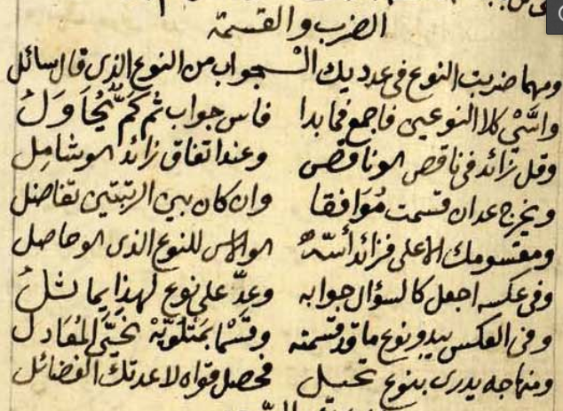
Poem Sections: Multiplication and Division
Multiplication:
Whenever you multiply a number by a type (a root, a square, or a cube), the answer will be of the same type
Whenever you multiply a type ax^{n} by another type bx^{m} (or by itself), the answer will be abx^{n+m}
Sign multiplication rules apply
Division ax^{n}/bx^{m}
If m = n, the answer is a number
If n > m, then the exponent of the answer is n - m
If n < m, then the result is the same as the question ax^{n}/bx^{m}
When dividing any type by a number, the exponent of the result will be of that type

Slide 16
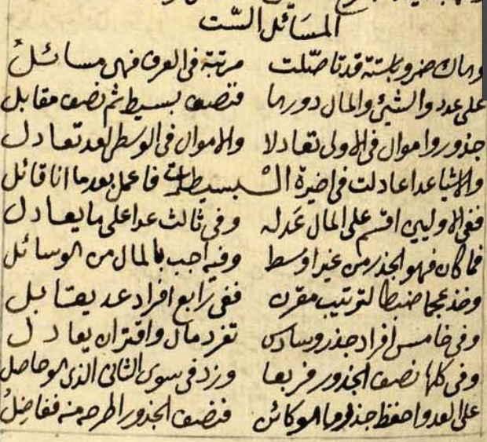
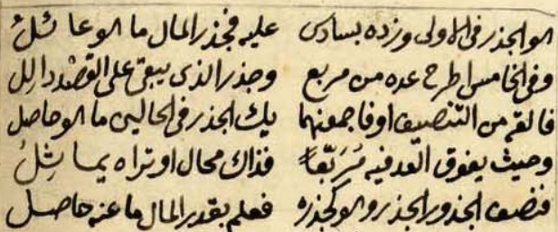
Poem Sections: The six canonical equations
The six equations (types) include just number, Jidhr (root), and māl (square).
The first three equations are called simple.
The other three are called compound.
Simple equations:
Type I: Squares equal roots:
Type II: squares equal a number:
Type III: Roots equal a number:

Slide 17
Poem Sections: The six canonical equations
Solutions of simple equations:
Type I : and Type II:
Divide terms on both sides of the equation by the number of squares.
Type III:
Divide terms on both sides of the equation by the number of roots.
The answers of Types I and III will be roots, and of Type II will be one square.

Slide 18
Poem Sections: The six canonical equations
Compound equations
Type IV: The numbers are isolated.
Type V : The roots are isolated.
Type VI : The squares are isolated.
Ibn al-ha’im explains a solution of these equations where there is just one square (māl), and if there are more, we need to follow some steps to make it just one square (māl).

Slide 19
Poem Sections: The six canonical equations
Solving Type IV and Type VI
Step1: Square half of the root:
And he calls the bisection.
Step 2: Add the result to the number:
Step 3: Find the root of the result:
Let
Step 4:
In Type IV,
In Type VI,
The answer will be a root in both cases.

Slide 20
Poem Sections: The six canonical equations
Solving Type V
The answer is a root.

Slide 21
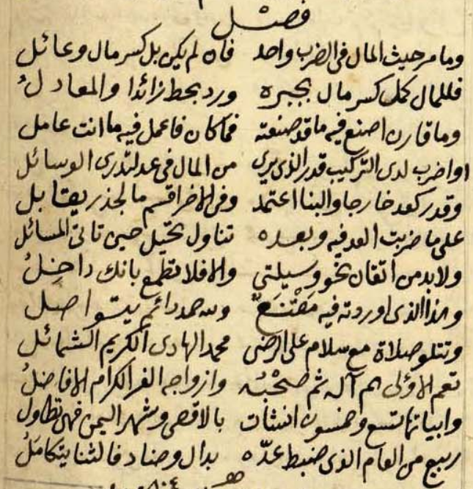
Poem Sections: Wrap up
If there is more or less than one square (māl), we have to follow some steps to make it one, and Ibn al ha’im explains two methods for this in his Wrap up.
The poem ends, as it started, by thanking the creator and praising his prophet.

Slide 22
Conclusions
The poem was constructed to be used as a pedagogical tool; versified poems are easier to remember than mathematical rules [5].
The poem abstracts the known algebra rules at that time.

Slide 23
References
[1] (Egyptian National Library)
http://www.alukah.net/library/0/99918/
[2] (Library of Congress)
https://www.wdl.org/ar/item/2844/
[3] (First interpretation of the poem)
https://dl.wdl.org/3202/service/3202.pdf
[4] (Definition of al-jabr wa’l-muqābala by Mohammed ibn-Musa al-Khowarizmi)
http://www.und.edu/instruct/lgeller/algebra.htm
[5] Abdeljaouad, Mahdi, 2005b. “12th century algebra in an Arabic poem: Ibn al-Yāsamīn’s Urjūza fi’l-jabr wa'l-muqābala”. Llull 28, 181-194.
[6] (Second interpretation of the poem)
https://www.wdl.org/en/item/4291/

Slide 24
Acknowledgments
NMSU Department of Mathematical Sciences.
MAA MathFest

Slide 25
Thank you
ishraq@nmsu.edu
ishraq1980@yahoo.com

Slide 26
Poem Sections: The six canonical equations
Solve Type V by following these steps:
Case 1. If
Step 1:
Subtract the number from the square of the bisection.
Step 2:
Find the root of the answer.
Step 3:
Subtract the radical from the bisection, or add the radical to the bisection.
The answer is a root.

Slide 27
Poem Sections: The six canonical equations
Case 2. If , it is impossible to find the solution.
Case 3. If , then the root is the bisection.

Slide 28
Poem Sections: Wrap up 1
In the Wrap up, Ibn al-ha’im explained two methods to solve the six canonical equations when there are less than or more than one Mal (square).
First Method (General method):
Example: If you want to solve
Step 1:Divide 1 by the number of squares (amwal)
Step 2: Multiply your equation by the result, then your equation will be
Now follow the same steps to solve this equation of Type IV

Slide 29
Poem Sections: Wrap up 2
Second Method:
If you want to solve
Step 1: Multiply your equation by a
Step 2: Assume that
Your equation will be
Step 3: Find the value of by Solving the equation as mentioned before
Step 4: Divide by a to find the value of x.
Example: Solve
Step 1: Multiply your equation by
Step 2: Assume that
Your equation will be
Step 3:
Step 4:

